Slide 1

PHG Grammar Manual

Slide 2
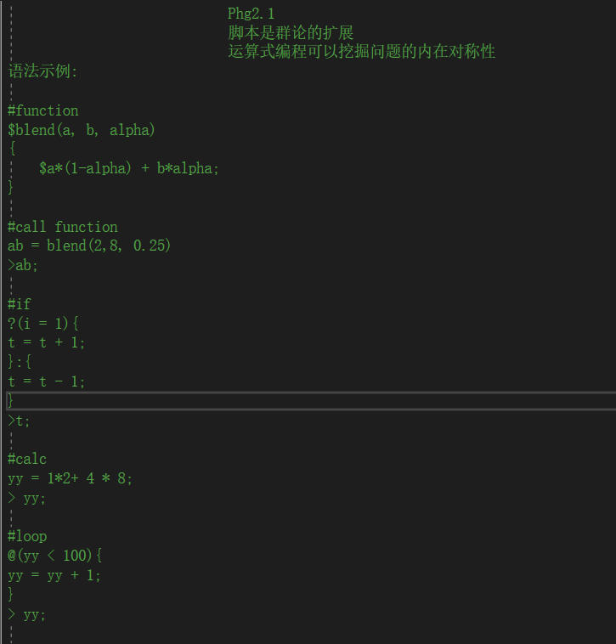
PHG is a minimalist programming language
PHG is a minimalist programming language named after bacteriophage. This language combines the idea of group theory to carry out custom overloading of variables and operation elements in the host program.
{PHG} is a specialization PHG for describing the structure of nodes, which is a descriptive language. The nodes it describes can be given any meaning, such as 3D scene nodes, 2D sprite nodes, etc. Internally combines some special syntax and embedded PHG statements to describe complex scenes with the simplest text.

Slide 3
Basic Concept
Define {a}, define a node a.
Property property : value;
Attribute attribute = value;
Inherit {a}, inherit properties from existing nodes, but not properties
Array[a,b,c] and Queue<a,b,c> (see page 4 for details)
Immediate statement (phg) immediately executes the PHG statement enclosed in parentheses

Slide 4
Sequences and Arrays
A sequence refers to an ordered N-tuple, and the sequence itself can be used as an element to participate in four operations
<a,b,c,d>
The relationship formula between sequence and node expression:
<a,b,c,d> = {a{b{c{d}}}}
Arrays are the concept of arrays and can also perform Boolean operations according to set theory
[a,b,c,d] = {{a}{b}{c}{d}}

Slide 5
Basic Syntax - Symbols
#comment
@cycle? :condition
$ function and return
~ escape symbol
> print symbols
; end symbol
{},[],<> node definition symbols

Slide 6
Basic Syntax - Variables
Basic variables are divided into integers and floating-point trees, which can be directly defined as:
a = 1; b = 0.1; >a+b; (print the value of a+b)
Variables can also be node names defined in the tree structure
Variables can be customized by the host program, and corresponding operations can also be customizedme is the current operation node

Slide 7
Basic Syntax - Control Statements
Conditional statements:
?(expr){ statement }:{ else statement }
?(expr) statement1; : statement2
Loop statement:
@n{ statement1 ?(_i = x) ˜;statement2 }
@ (expr){ statement }

Slide 8
Basic Syntax - Functions
Functions are divided into script custom functions and host API functions
Custom function format:
$function(args...) { statement $return }
Call method:
function(args);

Slide 9
Basic Syntax - Tree Structure
The tree structure is the data object of PHG, corresponding to the class or structure
How to define a tree structure ：
Example ：
{
a{ p:1,0,0;
b{p:2,0,0}
<a,a,a>
[a,a,a]
}
}
name : {
Inherit node name ,
property = value;property: value;
name: { child node }
? selector [ a:{},{b},c] #array
<a,b,c> #Queue
Phg/onevent : PHG expression
}

Slide 10
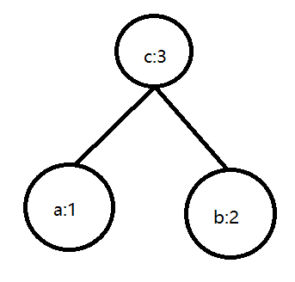
Expansion-Addition Tree
The addition rule can be expressed in a tree structure:
For example a+b=cA and b are attached to a certain feature, and c has the sum of the features of ab

Slide 11
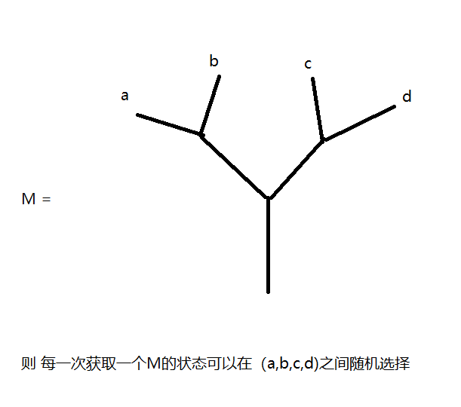
Extension - random selection of polymorphism
Carry some concepts of physics
Select subformat: ?1/M[a,b,c,d]
Choose from multiple possible states

